Slide 1
John Swift – Academy Coordinator
Jennifer Raley & Robin Swartz –
Advisory Board Co-Chairs
Kevin Garay – Principal

Slide 2
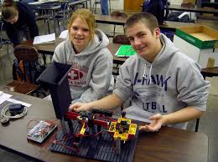
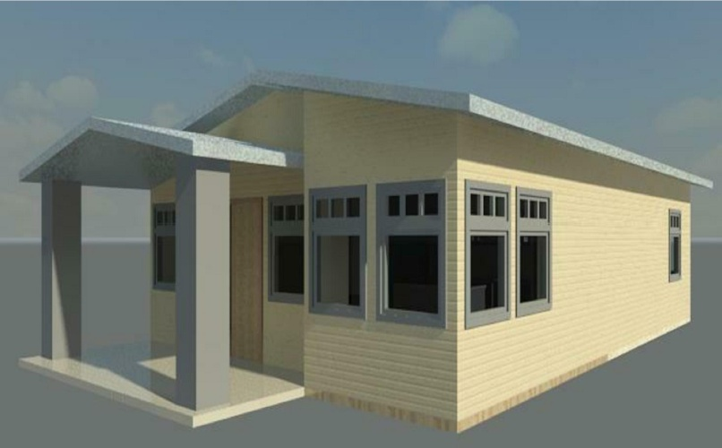
What is it??
A Program that answers an acute need for engineers in this country by educating high school students in the principles of engineering, and providing content in the fields of electronics, biotech, aerospace, civil engineering, and architecture.

Slide 3
What skills do I need?
Skills Needed:
Curiosity
Open-mindedness
Creativity
Hard working
A willingness to learn
Skills Gained:
Critical Thinking
Innovative
Environmental Consciousness
Time Management
Efficiency

Slide 4
Did You Know??
The word engineer means “to design and build.”
Engineers solve practical problems by applying mathematical and scientific knowledge.
Engineering can be applied to all types of interests and careers.
AOE gives you skills that can be applied to every subject and every obstacle you’ll encounter in life.

Slide 5
Top 10 Majors by Salary Potential

Slide 6
Branches of Engineering
Aerospace
Biomedical
Chemical
Civil
Computer
Electrical
Environmental
Forensic
Mechanical
Military
Nuclear
Software
Structural
Genetic

Slide 7
Last Year In Review
Class of 2015 signaled the seventh year of the Maverick Academy of Engineering
100% AOE Graduation Rate
95% of AOE Class of 2015 went on to college or the military
100% of AOE graduates since 2012 have completed a paid internship
$536,300 in scholarships were awarded to AOE Class of 2015

Slide 8
Expectations of Students
9th Grade Year PLTW Introduction to Engineering*
10th Grade Year PLTW Principles of Engineering*
11th Grade Year PLTW Civil Engineering and Architecture*
INTERNSHIP DURING SUMMER AFTER 11TH GRADE
12th Grade Year PLTW Digital Electronics*
*All PLTW courses in the AOE are worth one additional quality point; the same as an Advanced Placement course

Slide 9
AOE Honors
Completion of all AOE Requirements
Cord to be worn at graduation
AOE diploma with distinction
Possible undergraduate credits from Rochester Institute of Technology or University of Iowa
Potential to earn NAFTrack certification which provides preferential hiring practices from major corporations nationwide

Slide 10
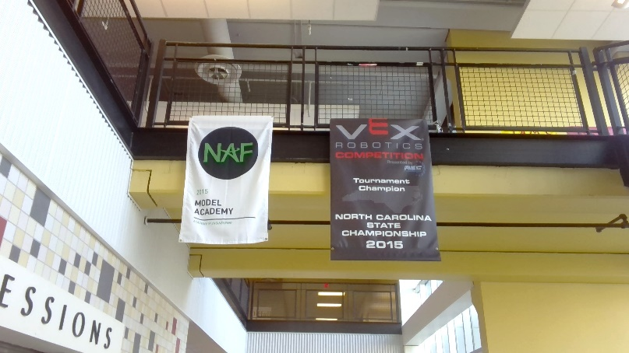
Technology Club
TSA – Technology Student Association
VEX Robotics
Both organizations offer plenty of opportunities to extend classroom learning through hands-on projects and activities
Meet afterschool as needed
Many competitions & trips

Slide 11
Who’s Who?
John Swift – AOE Academy Coordinator johnnyl.swift@cms.k12.nc.us
Dr. Lewis Davidson – PLTW Instructor lewis.davidson@cms.k12.nc.us
Tabatha Conley – Instructional Coordinator tabatha.conley@cms.k12.nc.us
Kevin Garay – Principal kevint.garay@cms.k12.nc.us

